Slide 1

By Bill Sun and Umair Malik
#$w@g Productions Inc.

Slide 2


Goals of the Game
This is a survival game. There is no end to the game
There can be infinite levels. Each level will be harder than the previous one
The players must shoot and kill the enemies (zombies and exploding creepers) to pass each level
There is friendly fire!
Blood packs can be collected to restore player health
Kill time and have fun!

Slide 3

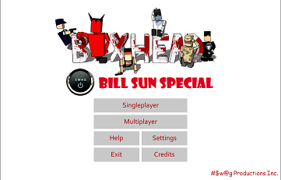



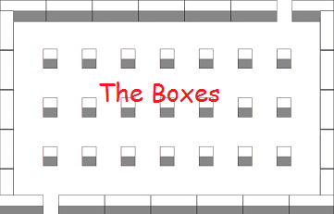


Features of the Game
Well-organized menu pages
Sound effects
Multiplayer option
A selection of maps with different wall formations
A selection of characters
Infinite levels

Slide 4
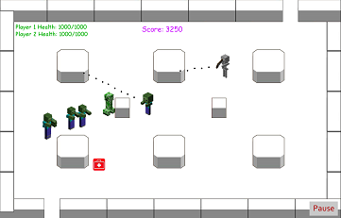
New Features to be Added
More weapons
Weapon upgrades
Record high scores
Animated characters
Fake walls and barriers
Resurrection of players
New types of enemies (e.g. shooting skeletons)

Slide 5
Marketing Strategies
The game is endless, which allows the players to keep playing to achieve higher scores
Player resurrection and health packs will keep them in game for a longer time
The selection of maps and characters gives the players more style and choice

Slide 6
Thank you and enjoy the game!

